Slide 1
Taking Action
Against
Elder Abuse

Slide 2
What is Elder Abuse?
Notes:
Explain that this activity is aimed at getting participants to think about how they would describe Elder Abuse to a client or to someone in the general public.
Think about how you would describe “Elder Abuse” by identifying:
What it is, and
What it is not.
Facilitator Questions:
What stands out or resonates with you?
How does this relate to your own previous experiences in addressing elder abuse?
How would a common definition help your organization or service providers?
Having a common definition is important. What steps can you take to establish one for your community?
Summarize discussion with key messages:
Elder abuse refers to a pattern of behaviour rather than a one-time incident
It is important to differentiate between conflict and elder abuse.
Conflict is a natural part of life and is part of decision making and living and working with others
Elder abuse is not about resolving problems, but rather is about exerting power and control over another person

Slide 3
The Unique Nature of Elder Abuse
Elder abuse is any action or inaction by self or others that jeopardizes the health or well-being of any older adult and is divided into six categories:
  physical
  neglect
  emotional
  financial
  sexual
  medication
Notes:
Stats 1999 General Social Survey – approximately 23,000 Alberta seniors experience elder abuse
Becoming more of a health concern
2031 – 1 in 5 Albertans will be a senior
Approximately 25% of crimes against older adults are committed by family members (spouse or adult child)
Definitions: provide common language among service providers
Quebec example: includes human rights
Elder abuse used as an all inclusive term
In order to describe to seniors - Lets take a minute to think about how you would describe elder abuse – what it is and what it is not

Slide 4
Who is abused?
Any older person can be a victim of elder abuse
It doesn’t matter the gender, income level, race, ethnicity or educational level
People with physical or mental health issues are at greater risk

Slide 5
Who Abuses Older Adults
Most people who abuse older adults are relatives – but can also be a friend, neighbour, paid care provider, landlord or any individual with a position of trust, power or authority.
71% of abusers were a spouse, adult son or adult daughter (Statistics Canada 2002)
Can be a continuation of spousal abuse
Older women are more likely to be abused by their husbands; Older men are more likely to be abused by their sons.

Slide 6
Risk Factors
History of spousal abuse
Family dynamics
Isolation
Troubled relatives, friend or neighbors
Inability to cope with long-term care giving
Institutional conditions
Ageism & lack of knowledge about the aging process
Society’s acceptance of violence

Slide 7
Indicators
Indicators for different types of elder abuse may differ based on a victim’s characteristics, such as:
Age
Cognitive ability
Gender
Past experiences
Community support
Family structure
Abuse or elder abuse tactics used
Notes:
While there are a number of signs that may indicate elder abuse, it is important to be aware that not everyone who is a victim of elder abuse will exhibit signs. As well, not all people who exhibit signs are victims of elder abuse. Nevertheless, there are some common signs and symptoms attributed to elder abuse.

Slide 8

Financial Abuse Indicators
Theft or misuse of a senior’s money or property.
Indicators:
Standard of living not in keeping with income or assets
Theft of property
Unusual activity in bank account
Forged signatures on financial documents
Coercion used in signing of wills or releasing property; overdue bills
Limiting a senior’s access to his or her own accounts

Slide 9
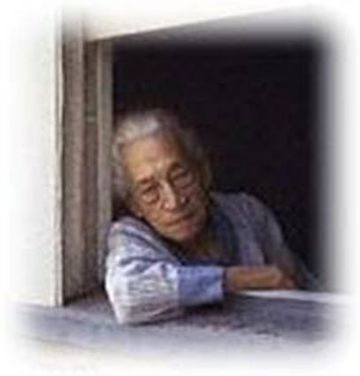
Emotional Abuse Indicators
Actions or statements that cause emotional anguish, diminished self-esteem or dignity.
  Fear
  Anxiety
  Depression
  Withdrawal
  Cowering
  Secrecy
  Fearful interaction with caregiver
  Caregiver speaking on behalf of senior
  Not allowing privacy
  Physical signs of isolation

Slide 10
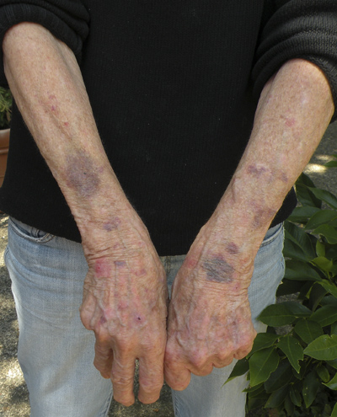
Physical Abuse Indicators
Action that causes physical discomfort, pain or injury.
Unexplained injuries such as bruises, burns or bites
Missing hair
Untreated medical problems or history of injury
Harming or threatening to harm
pets
Confinement

Slide 11
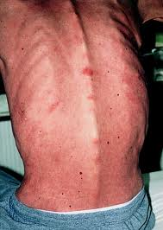
Neglect Indicators
Intentional or unintentional failure to provide for the basic needs of someone.
Inappropriate or dirty clothing
Poor hygiene
Dehydration
Unsafe living conditions
Lack of social contact
Irregular medical appointments
Lack of, or poor conditions of, dentures, glasses, or hearing aids

Slide 12
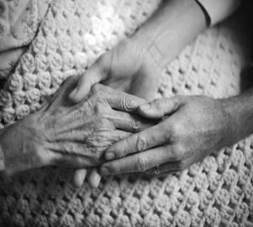
Sexual Abuse Indicators
Unwanted sexual behaviour including sexual comments, exploitive use of pornography, fondling or sexual assault.
Pain
Bruising or bleeding in the genital or chest area
Sexually transmitted illnesses
Recent depression
Recent incontinence

Slide 13

Medication Abuse Indicators
Intentional or unintentional misuse of medications and prescriptions, such as withholding or providing doses that cause bodily harm, sedation or other adverse effects.
Changes in mental ability or physical ability
Decline in general health status including
  Confusion
  Poor balance
  Falling
  Depression
  Recent incontinence
  Agitation

Slide 14
Challenges of Recognizing
Complex issue which makes it difficult to recognize.
Own beliefs, values and biases
Lack of awareness – who is out there
No visible or observable signs
Plausible explanations for visible signs
Not all forms are recognizable
Aging considerations
Victim denial
Notes:
Elder abuse is a complex issue and that there are challenges that can make recognizing difficult.
Some of these factors are:
Own beliefs, values and biases
Lack of awareness – who is out there
No visible or observable signs
Plausible explanations for visible signs
Not all forms are recognizable
Aging considerations
Victim denies
Recognition of elder abuse involves:
Determining vulnerabilities and risks
Determining what, where, when, why and how
Attempting to understand nature of risk
Determining the resulting level of that risk
Comparing the level of risk against the criteria that determine the significance of the risk

Slide 15
Why seniors are reluctant to report
What are some reasons that seniors are reluctant to report abuse?
  Love for the abuser
  Hope for change
  Fear of institutionalization
  Fear of losing a caregiver
  Unable to report
  Hopelessness
  Shame
  Guilt
  Unaware of resources
Notes:
In many cases of elder abuse, older adults are often reluctant to report abuses against themselves.
What do you see as barriers to disclosure?
Therefore; it is important to consider these factors whenever dealing with an older adult that you might suspect is being abused

Slide 16
Reporting
Twenty-four percent of respondents did not tell anyone about the abuse they were experiencing. (2006)
54% said their abuse was reported to the police.
Of those, 33% said the report was made by someone other than themselves. (2006)

Slide 17
The Advocacy Wheel
P
Promote access to community services
Respect confidence
Help her/him plan for future safety
Believe her/him and validate the experience
Respect her/his autonomy
Acknowledge the injustice
Notes:
The Advocacy wheel illustrates basic principles that guide responses to individuals affected by elder abuse.
1. The basic requirements of life: food, clothing, shelter and social contact.
2. Live without physical, emotional, financial, sexual and medical abuse and neglect.
3. Be informed about heir civil and legal rights and live free from violation of these rights.
4. Participate in making decisions about themselves, to the full extent of their ability.
5. Refuse assistance and intervention.

Slide 18
How can you help?
Acknowledge: Accumulate/document evidence of suspected abuse .
Barriers: Speak to the senior about any concerns he or she may have about fear or retaliation, with drawl of support and confidentiality.
Urgency: Assess if basic life necessities are being provided or whether there is an immediate risk of physical harm.
Screen: Assess the senior’s ability to make an informed decision and his/her desire to receive help.
Empower: Inform the senior of the right to live free of abuse and the resources available to support this. Establish a safety plan.
Refer: Seek support or consultation from other professionals and suggest resources to the senior.

Slide 19
4
R
Response Model
Refer
Reconnect
Recognize
Respond
Recognize
Respond
Front-line
Staff
Reconnect
Refer

Slide 20
Protective Laws
Criminal Code of Canada
  Physical and sexual abuse
  Neglect
  Property theft
  Breach of trust
  Breach of power of attorney
  Extortion, fraud, false pretences
  intimidation
Protection Against Family Violence Act
  Emergency Protection Order
  Access to premise

Slide 21
Protective Laws
Mental Health Act
  A danger to self or others
  Cognitive impairment
Family Law Act
  Obtaining guardianship of grandchildren
  Financial worry of leaving a spouse
  Obtaining support orders

Slide 22
Protective Laws
Public Health Act
  Individual can be removed from a home
  Investigation to identify possible situation of neglect
Adult Guardianship and Trusteeship Act
  Outlines decision making options
Protection for Persons in Care Act
  Outlines the duty to report within publicly funded
  Mandatory reporting required

Slide 23
Protective Laws
Freedom Of Information and Privacy Act
  Governs and protects the privacy of individuals
Health Information Act
  Outlines rules and limitations for the collection, use, or disclosure of health information
Powers of Attorney Act and Personal Directives Act
  Financial and personal decision – making tools
  Handout - Privacy Legislation Guide

Slide 24
Supportive Decision Making
 | Decisions Made by you | Decisions Made by Court
Personal | Personal Directive Supportive Decision Making Specific Decision Making (one time) | Guardianship (AGTA) Co-Decision Making
Financial | Enduring Power of Attorney | Trusteeship (AGTA)
After Death | Will | Intestate Succession Act

Slide 25
Example of a Community Response Model
Police
Senior’s Centre
Health care
Rural Crime Watch
Victim of Elder Abuse
Victim services
?
Hospital
SPA

Slide 26
Safety Planning
What is a safety plan?
What are the strategies?
Why do we encourage safety planning?
How good are safety planning measures?
When should a safety plan be revisited?
Who should keep the safety plan?
What are some of the legal tools available?
What’s your role in safety planning?
Notes:
Safety planning is one strategy to reduce harm. Helps the victim feel safer and can provide life-saving strategies.
It is individualized with specific strategies that aim to improve the victim’s ability to negotiate their daily life without fear or intrusions from an abuser.
Typically include: tactics to improve physical safety, which include steps to escape, how to prepare for the next time abuse occurs, information on community resources and plans for prevention.
Safety planning activities include:
Engaging the victim in a discussion about the options
Discussion on what has been tried before, what worked and what did not.
Having an understanding of the victims strengths – limitations, etc.
Safety plans are best accompanied with risk and threat assessments, counseling and/or advocacy support. Safety plans build on factors of risk.
They vary depending on the individual and abuse identified.
Should not be shared with perpetrator.

Slide 27
Additional Resources
                Kristel Kirstein at Canadian Mental Health – Seniors Outreach Worker: 403-504-1811 ext. 114
Alberta Elder Abuse Awareness Network (AEAAN):
  www.albertaelderabuse.ca
Older Adult Knowledge Network: www.oak-net.ca
Canadian Network for the Prevention of Elder Abuse: www.cnpea.ca
Alberta Family Violence Information Line:
  310-1818 (toll-free, 24 hours)
  www.humanservices.alberta.ca/abuse-bullying/14839.html
HealthLink Alberta: 1-866-408-5465

Slide 28
Additional Resources
CRANE (Community Response To Abuse and Neglect of Elders)
    (403) 529-4798
Medicine Hat Police Victim Assistance Unit
    (403) 529-8480
Protection for Persons in Care
    1-888-357-9339.
Medicine Hat Women’s Shelter (24 hour Crisis Line)
    (403) 529-1091
    Safeguards for Vulnerable Adults Information and Reporting Line
    1-888-357-9339

